Slide 1
AI ENABLED FINTECH B2B INVOICE MANAGEMENT APPLICATION (HRC-TECH TRACK)
Name: Rahul Pandey
UID: 19BCS2953 Project Techer:
HRC ID: HRC21216W Prof. Richa Dhiman

Slide 2
TABLE OF CONTENTS
1. Introduction/problem statement
2. Features
3. Advantages
4. Technologies used
5. Tables/Figures
6. Result /Conclusion /Future Work
7. References

Slide 3
INTRODUCTION/PROBLEM STATEMENT
The B2B world operates differently from the B2C or C2C world. Businesses work with other businesses on credit. When a buyer business orders goods from the seller business, the seller business issues an invoice for the same. This invoice for the goods contains various information like the details of the goods purchased and when it should be paid. This is known in accounting terminology as “Accounts Receivable”
In the ideal world, the buyer business should payback within the stipulated time (i.e. the Payment Term). However, in the real world, the buyer business seldom pays within their established time frame, and this is where the Account receivables Department comes into picture. Every business consists of a dedicated Account receivables Department to collect and track payment of invoices.
It consists of a Account receivables team that is responsible for:
Collecting payments from customers for their past due invoices.
Sending reminders and follow ups to the customers for payments to be made.
Looking after the entire process of getting the cash inflow.
Help the company get paid for the services and products supplied.
Build a Machine Learning Model to predict the payment date of an invoice when it gets created in the system.
Build a full stack Invoice Management Application
It’s typical for small businesses not to have a dedicated finance department to handle accounts payable. Hence, the task of billing and invoicing is handled by you or a couple of other people
Create and customize invoices, Facilitate billing and payment, Generate report.

Slide 4
FEATURES
Although invoicing solutions vary widely in terms of feature set, the target uses, and pricing, they do share standard functionalities. A respectable app should have the following features:
New invoice creation. Allows the creation of clean and professional invoices that can be customized to match your brand. The system should allow for extracting and integrating information from projects, timesheets, and customer records.
Customer records creation. A feature that enables you to summarize customers’ personal and purchase information and attach relevant files in a single, centralized database equipped with search filters for easy access to customer records.
Credit card processing. The invoicing suite should enable you to save time and facilitate billing by processing credit cards promptly and allowing recurring billing and secure customer management. Some systems even enable auto-billing of credit cards so clients won’t miss a due payment.
Predefined templates. How your bills and invoices look is equally important as their accuracy, which is why a system should provide for professional and predefined communication templates. This will not only save you time but also let you personalize your accounting and allow you to carry your brand.
Multiple currency settings. This feature enables you to connect your billing and invoicing system seamlessly with the rest of your software architecture, similar to your basic financial operations. Multiple currency settings can be useful for issuing receipts, accepting payments, and managing taxes, and it is of vital importance for businesses with global operations.

Slide 5
ADVANTAGES
Minimize late payments – The right software solution can help streamline your billing and invoicing process and allow you to get and receive payments on time. By keeping your data and schedules organized, you can have your collection on the dot and boost your profitability.
Minimize missed payments – By accurately monitoring and tracking your billing commitments, you ensure that you do not miss collecting any payments which will redound to a positive bottom line.
Maintain a professional image – A good billing and invoicing solution can help boost your company’s reputation. Most software offer support for customized logos and other design improvements to payment documents and invoices. You can put forward an organized and prompt approach to exude a professional image with your clients.
Help streamline your accounting and financial processes by automating important tasks. You can cut costs by reducing staff in the invoicing and billing department and save time that is spent on following up and going after the late payers. Likewise, you get to increase cash flow with faster payment of invoices and enhance customer relations with shorter times in fixing and resolving errors.
Minimize fraud and improve security. A good invoicing software solution has levels of bank-grade security features to ensure that the entire billing-to-payment process is protected from hacks or prying eyes. This is comparatively more secure than preparing your invoices manually and sending them as email attachments.

Slide 6
TECHNOLOGY AND TOOLS
Pandas: Pandas is an open source Python package that is most widely used for data science/data analysis and machine learning tasks.
Numpy: Using NumPy, mathematical and logical operations on arrays can be performed. NumPy is a Python package. It stands for 'Numerical Python'.
Matplotlib: Matplotlib is a plotting library for the Python programming language and its numerical mathematics extension NumPy
Scikit-learn: Scikit-learn is probably the most useful library for machine learning in Python.
HTML: The HyperText Markup Language or HTML is the standard markup language for documents designed to be displayed in a web browser. It can be assisted by technologies such as Cascading Style Sheets and scripting languages such as JavaScript
CSS: Cascading Style Sheets is a style sheet language used for describing the presentation of a document written in a markup language such as HTML. CSS is a cornerstone technology of the World Wide Web, alongside HTML and JavaScript.
JavaScript: JavaScript, often abbreviated JS, is a programming language that is one of the core technologies of the World Wide Web, alongside HTML and CSS. Over 97% of websites use JavaScript on the client side for web page behavior, often incorporating third-party libraries
JQuery: jQuery is a JavaScript library designed to simplify HTML DOM tree traversal and manipulation, as well as event handling, CSS animation, and Ajax. It is free, open-source software using the permissive MIT License. As of May 2019, jQuery is used by 73% of the 10 million most popular websites

Slide 7
TECHNOLOGY AND TOOLS
Java: Java is a high-level, class-based, object-oriented programming language that is designed to have as few implementation dependencies as possible.
Servlets: A servlet is a small Java program that runs within a Web server. Servlets receive and respond to requests from Web clients, usually across HTTP, the HyperText Transfer Protocol. To implement this interface, you can write a generic servlet that extends javax. servlet.
JDBC: Java Database Connectivity (JDBC) is an application programming interface (API) for the programming language Java, which defines how a client may access a database. It is a Java-based data access technology used for Java database connectivity. It is part of the Java Standard Edition platform, from Oracle Corporation
JSP: Jakarta Server Pages is a collection of technologies that helps software developers create dynamically generated web pages based on HTML, XML, SOAP, or other document types. Released in 1999 by Sun Microsystems, JSP is similar to PHP and ASP, but uses the Java programming language
MySQL: MySQL is an open-source relational database management system.

Slide 8
TOOLS
Eclipse IDE: Eclipse is an integrated development environment used in computer programming. It contains a base workspace and an extensible plug-in system for customizing the environment. It is the second-most-popular IDE for Java development, and, until 2016, was the most popular
TomCat Server: Apache Tomcat is a free and open-source implementation of the Jakarta Servlet, Jakarta Expression Language, and WebSocket technologies. Tomcat provides a "pure Java" HTTP web server environment in which Java code can run
Postman API Testing Tools: Postman is an API platform for building and using APIs. Postman simplifies each step of the API lifecycle and streamlines collaboration so you can create better APIs—faster.
SQL Yog: SQLyog is a GUI tool for the RDBMS MySQL. It is developed by Webyog, Inc., based in Bangalore, India, and Santa Clara, California. SQLyog is being used by more than 30,000 customers worldwide and has been downloaded more than 2,000,000 times.
Jupyter Notebook: The Jupyter Notebook is an open source web application that you can use to create and share documents that contain live code, equations, visualizations, and text. Jupyter Notebook is maintained by the people at Project Jupyter.

Slide 9
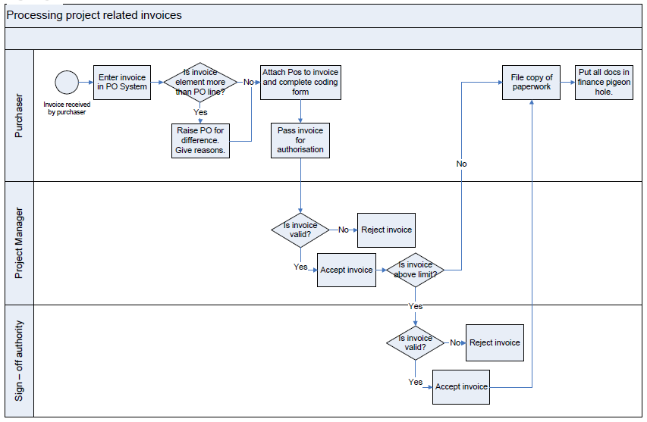
Table & Figures

Slide 10
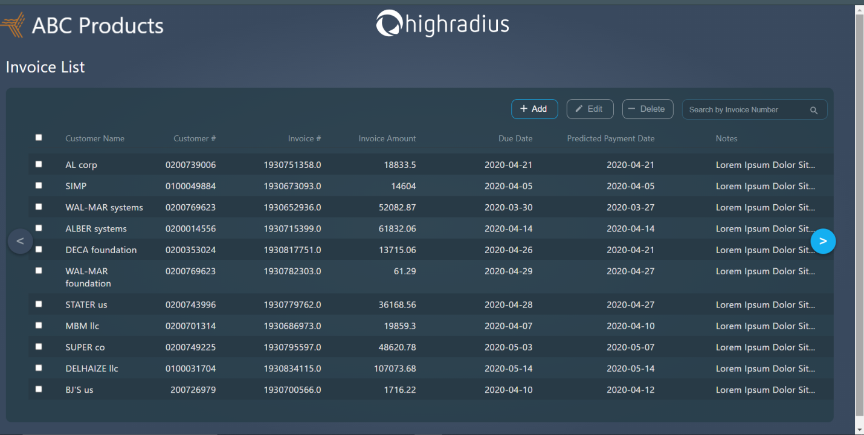
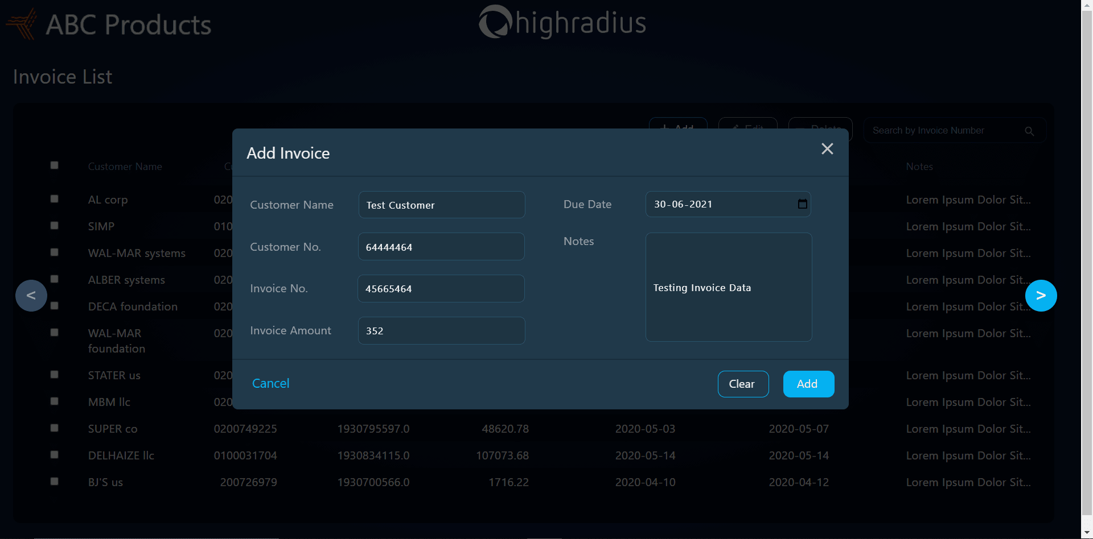
SCREENSHOTS

Slide 11
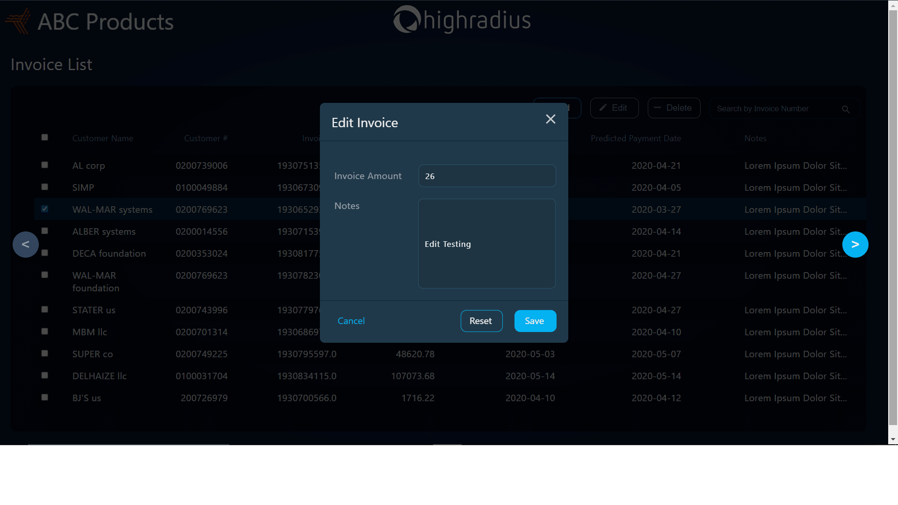
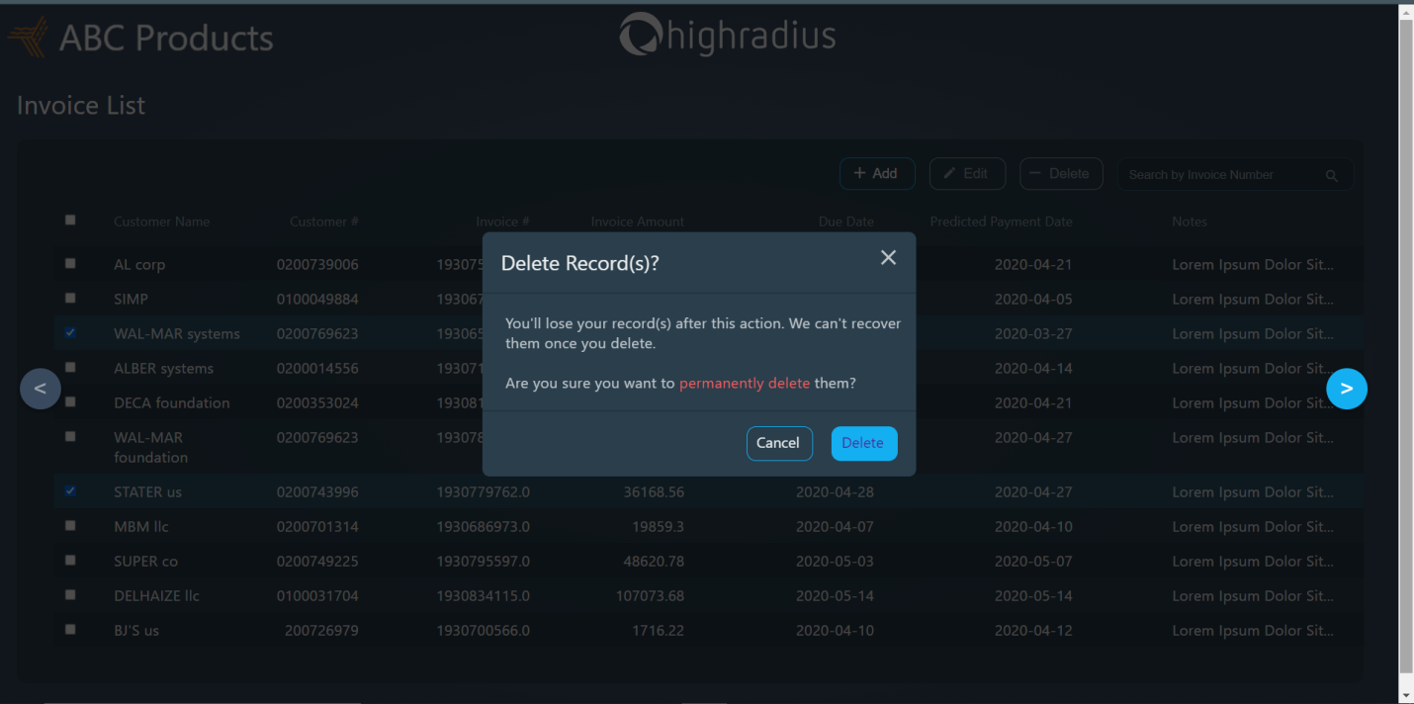

Slide 12
CONCLUSION/FUTURE WORK
During the tenure of my training at HighRadius, I had exposure to various technical languages which helped in shaping my analytical and problem-solving skills as well as provide knowledge that could be applicable in real-time projects as well. By making the Order Management System I was able to learn how a flow of code works and how to establish connections between different languages.
With the help of AI-Enabled Fintech B2B Order Management Application the organizations, companies, and in fact, individuals can keep track of the payment of their orders irrespective of a large number of clients. This will not only reduce time but also provide a functional manner for the proper functioning of an organization and/or workplace.

Slide 13
REFERENCES
https://www.google.com/search?sxsrf=ALiCzsagvhe-iPr528KEhSiprYD7Tn4m7A:1652032190498&q=What+are+the+steps+of+process+of+invoice+in+accounts+payable%3F&sa=X&ved=2ahUKEwiJ3fy-u9D3AhW-3jgGHQXsCGkQzmd6BAgaEAU&biw=1536&bih=722&dpr=1.25
https://zipordering.com/en/invoice-processing.html
https://docs.oracle.com/cd/E59116_01/doc.94/e58747/ch_over_inv_proc.htm#WEAAR158

Slide 14


